Slide 1
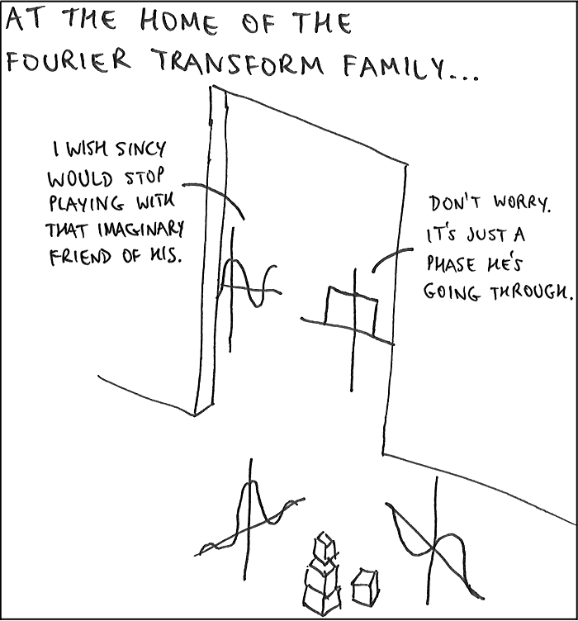
[LGBIO2020] TP2 - Fourier & Wavelets

Slide 2
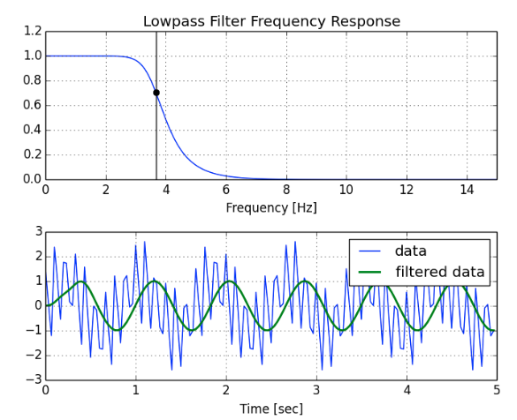
What is a filter?
Here a low pass filter...

Slide 3
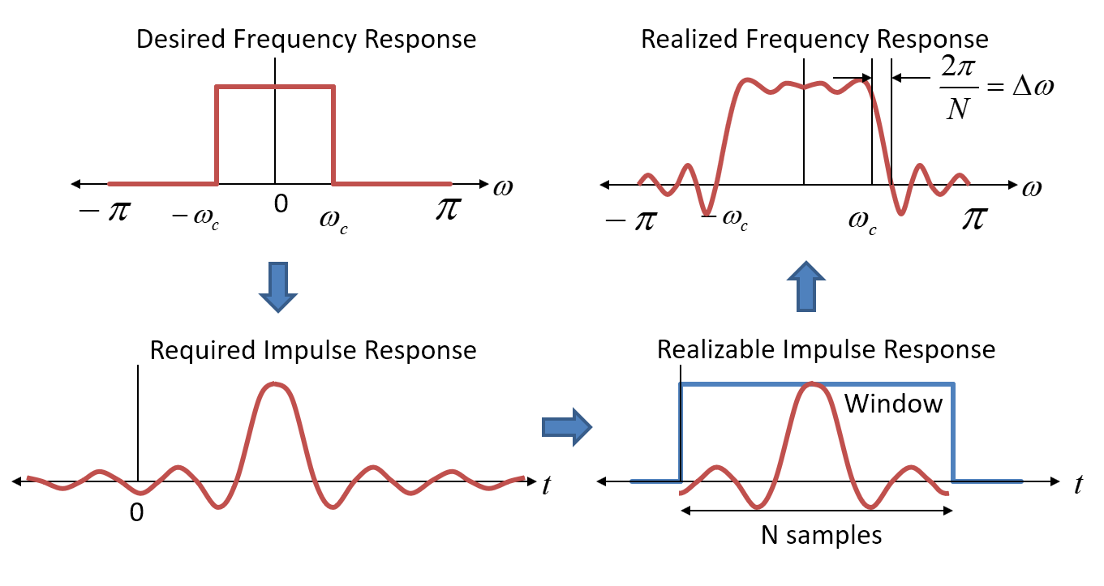
Why do I need Filter Design ?
What is Deep Learning ?

Slide 4
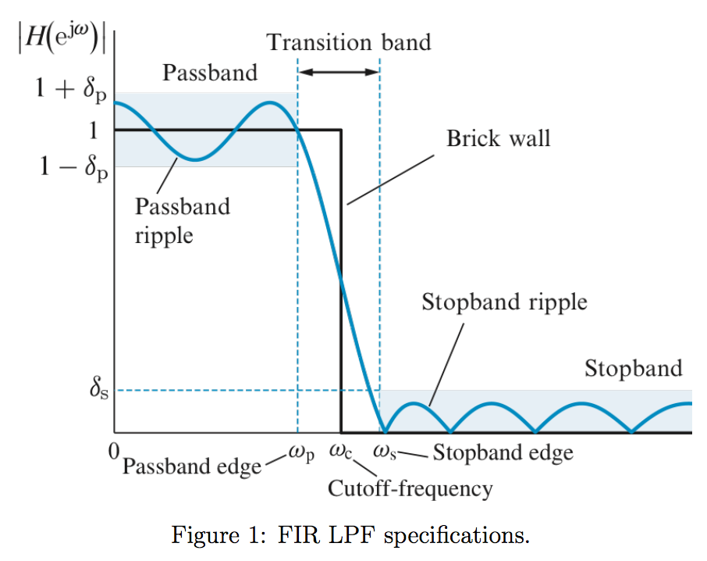

Slide 5
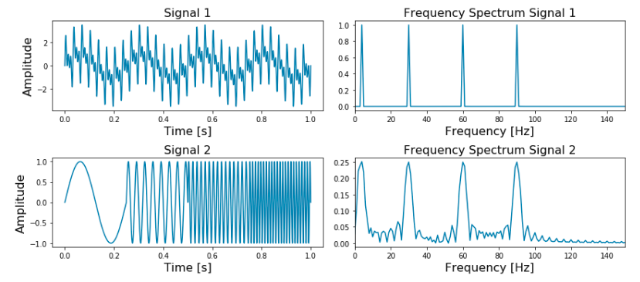
Fourier Transform has a limited time resolution...

Slide 6
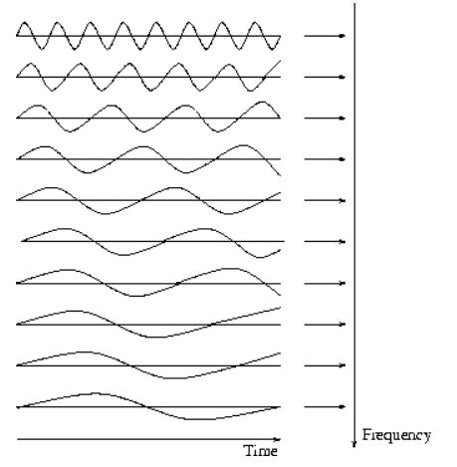
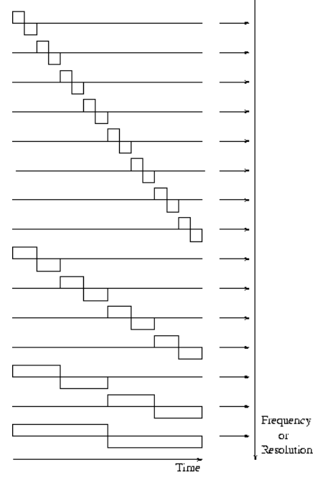
Fourier basis Haar Basis

Slide 7
Fourier basis Haar Basis
Localization: Fourier basis functions are localized in frequency but not in time. Small frequency changes in the Fourier transform will produce changes everywhere in the time domain. Sparse coding: Function with discontinuities and functions with sharp spikes usually take substantially fewer wavelet basis functions than sine-cosine basis function to achieve a comparable approximation
Low computational cost: Number of operations for DWT is proportional to the number of input sequence sample n (i.e. O(n)), which is best possible. Recall that FFT requires O(Nlog₂N).

Slide 8
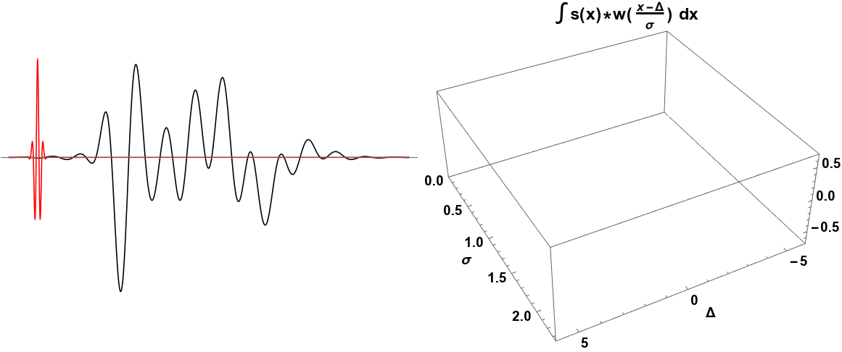
The Continuous Wavelet Transform (CWT)

Slide 9
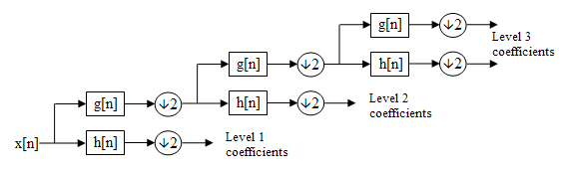
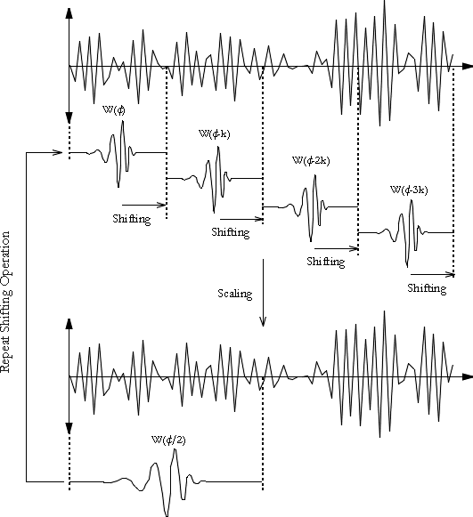
The Discrete Wavelet Transform (DWT)

Slide 10
